Slide 1












AstroSage Call Centre Analysis
Syeda Saima Nasreen
01-Feb-2026

Slide 2




Introduction to AstroSage Call Centre
Founded in 2000
Founder Punit Pandey
AstroSage is a leading, technologically advanced online platform that pioneered digital astrology by fusing traditional Indian wisdom with contemporary technology.
Through its well-known website and Astrosage app, AstroSage offers services like horoscopes, birth charts, numerology, tarot readings, and live consultations with experts, making astrology accessible worldwide.

Slide 3






Problem Statement
AstroSage has received a 1 crore investment and aims to optimize its call center operations. The goal is to determine how to allocate this investment to maximize operational efficiency, customer satisfaction, and profitability. The analysis will consider historical call data, performance metrics, and market trends to make informed decisions.

Slide 4


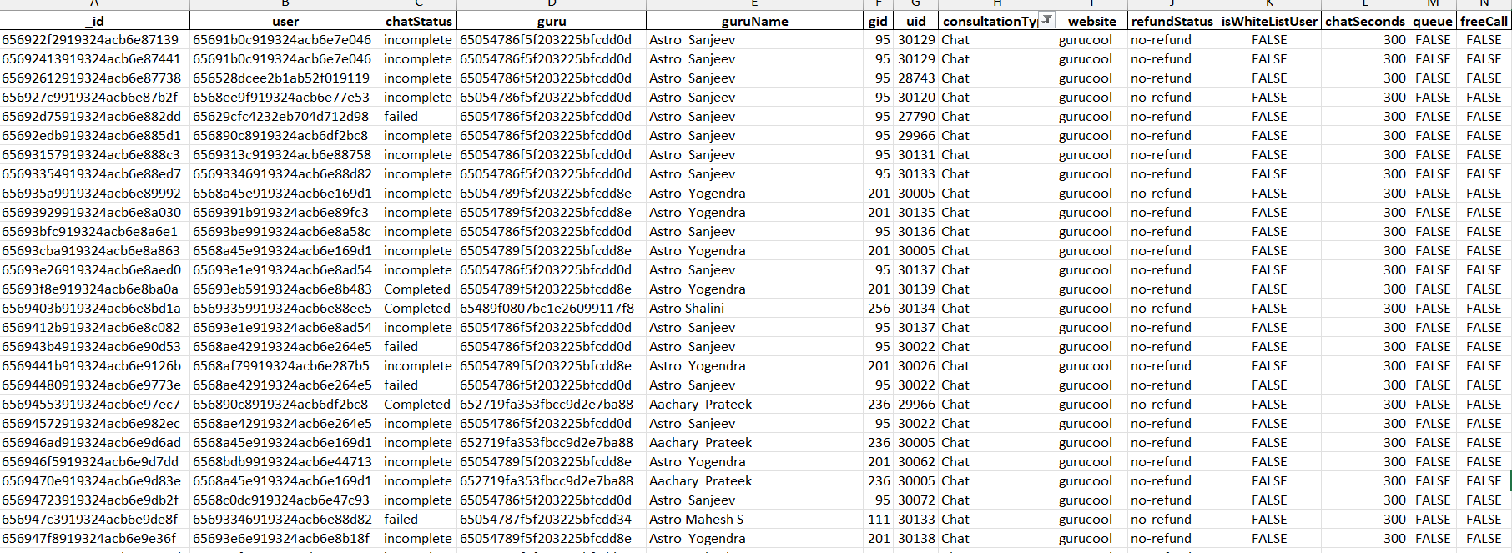
Data Overview

Slide 5





Data Overview
28027 Distinct users
149 Gurus in total
8513 Calls
19514 Chats
December and January are months
Year: 2023 ,2024
The analysis majorly revolves around these factors

Slide 6




Data Cleaning
Before we proceed with any data make sure that there are no duplicates is the essential step
Derived new columns such as Date, Month, Year, Day, Hour for date wise reports
To comprehend operational costs, customer satisfaction, and call center sales trends, a good dataset is essential.
We can forecast and recommend future investments to increase sales turnover thanks to this dataset.

Slide 7




Analysis using excel knowledge
Used DATE, TEXT, HOUR functions to derive new columns
Aggregation formulas such as Count, Average, Sum, etc
Used sorting and filter methods in pivot tables
Created charts for better display of analysis
A final dashboard with all the charts, slicers KPIs

Slide 8




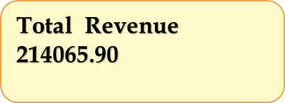





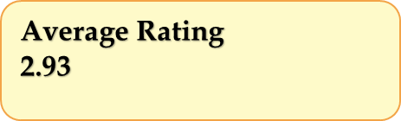

KPIs (Key Performance Indicators)
The Dashboard provides a view of Astrosage’s call centre performance
KPIs
Total Revenue
Total Calls
Total Chats
Average Rating
No of Days
Total no of Gurus

Slide 9




Total Revenue Generated
The Chart represents the total revenue generated by each consultation type(Call and chat)
Calls accounted for ₹1,68,493 (79% of total revenue), indicating that voice consultations are the call centre's main source of income.
Chats produced ₹45,495, or 21% of the total, suggesting a noteworthy but secondary source of income.

Slide 10




Hourly Call Volume
8–10 AM = peak calls + increasing chats = agents overworked.
Chat agents burn out more quickly since chats run from 6 AM to 8 PM (14 hours), while calls run from 6 AM to 6 PM (12 hours).
Indicates need for more agents during mid-day hour &lighter staffing at night.

Slide 11




Call Status Distribution
Almost six out of ten calls conclude without a resolution,with only 41% of calls being successfully finished.
This suggests a substantial service delivery or accessibility gap.
The fact that 35% of calls (15% busy + 20% no answer) go unanswered suggests that there may be a staffing shortfall, poor call timing, or inefficient call routing.

Slide 12



Chat Status Distribution
71% of chat engagements fail or are left unfinished, with only 29% of chats being finished.
This indicates that there is a lot of friction in the chat assistance procedure.
With 34% incomplete and 37% failed, the problem is probably operational (high wait times, agent unavailability) or technological (chat dropouts, problems).
To preserve channel effectiveness, an immediate assessment of chat platform stability and agent training is necessary.

Slide 13




Top 10 Gurus and No of Calls they made
Over 1200 calls were handled by the top guru, indicating a high call concentration and perhaps over-reliance or excessive demand on a small number of specialists.
Call volumes fluctuate considerably from 195 to 1200+, indicating an unequal workload distribution and a wide performance gap.
Call volumes vary significantly, ranging from 195 to 1200+, suggesting a large performance disparity and an uneven task distribution.

Slide 14



Top 10 Gurus by Rating
Strong start-of-call attentiveness is indicated by high participation in the first few minutes, with approximately 100% involvement at the five-minute point.
Quick decline after 10 minutes; by 15 minutes, participation is less than 50%, indicating difficulties with maintaining focus throughout longer calls.
Minimal long-term engagement—after 20 minutes, participation is almost nonexistent, indicating the need for call methods that are shorter and more targeted.

Slide 15

Rating vs Users
There are very few high scores (7–8), while the majority of evaluations are poor (0–3), suggesting possible discontent.
The majority of ratings are zero, indicating either insufficient data or a large number of inactive users.
The distribution is polarized, with consumers favoring mid-low ratings over neutral or extremely high ones.

Slide 16




Day Wise Call Volume
Sundays have the highest call volume (4,592), showing peak demand and a reliance on support during the weekend.
Tuesday through Thursday saw a midweek fall (less than 3,400 calls), indicating a decrease in consumer urgency or service demand.
Weekend rebound: Friday and Saturday call volumes above 4,200, demonstrating steady end-of-week engagement.

Slide 17




Website and Calls
With 72% usage, the app is the most popular platform for interacting with customers.
With only 28% of the total, Gurucool appears to be a secondary or specialized channel with far lower interaction.
Over-reliance on app such a large disparity (72% vs. 28%) may indicate a channel imbalance, underscoring the necessity of promoting Gurucool to diversify access and lower platform risk.

Slide 18



Key Strategic Insights
Skill-Based Routing Driven by AI
Based on experience, current availability, and previous satisfaction an automated routing system may match each caller with the most appropriate astrologer.
This keeps client satisfaction high, expedites resolutions, and avoids overwhelming individual agents.
Chatbots and Intelligent Self-Service
Many calls during busy hours are for straightforward inquiries, such as booking instructions or horoscope updates.
These can be quickly handled by a natural-language chatbot or voice-bot, freeing up human agents for more in-depth, customized consultations.
Wait times are reduced, and your team can concentrate on areas where they are most valuable.

Slide 19



Key Strategic Insights
Automated QA and Call Scoring
Manual quality reviews are uneven and take a long time.
AI may automatically evaluate calls for compliance, empathy, and clarity before producing tailored feedback for every agent.
This guarantees prompt, equitable assessments and transforms each conversation into a coaching opportunity.
Knowledge Support & Live Agent Assistance
Agents who are inexperienced or overworked can have trouble with accuracy or speed.
During live calls, a real-time assist tool might recommend astrological references, treatments, or response templates.
These speeds up handling time without sacrificing quality, acting as a quiet coach.

Slide 20




Conclusion
Profitability and customer happiness can be increased by modernizing technology and optimizing processes
Using chatbots for general queries will lower operational costs and reserve consultants for peak hours.
Focusing on call consultations can increase revenue and customer engagement.
Reward and keep top-performing morning shift experts by finding out what they do well.
Recognizing top consultants and organizing regular training will ensure consistent service quality.
Training is needed for gurus to efficiently solve problems to shorten call duration without affecting rating/satisfaction.

Slide 21
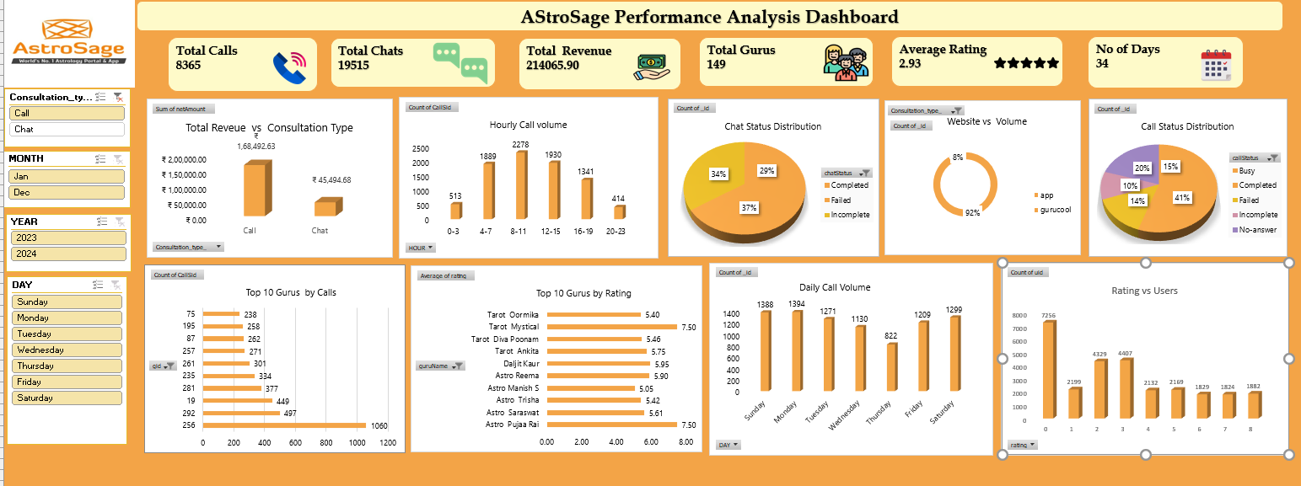

Slide 22



